Slide 1
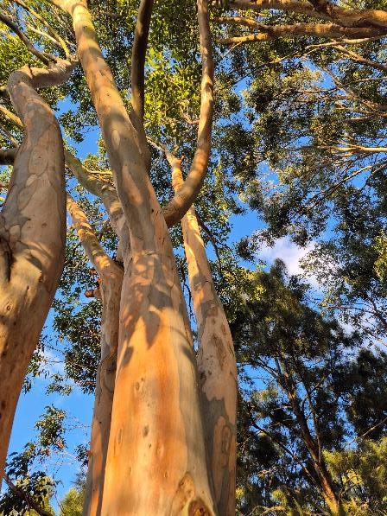
Acknowledgement of Country
I begin today by acknowledging the Gadigal of the Eora Nation, Traditional Custodians of land and knowledge in the place I live, learn and work and upon whose ancestral lands our UTS City campus now stands.
I pay my respects to the Elders past and present. I extend that respect to Aboriginal and Torres Strait Islander people here, and to Traditional Custodians of the lands of everyone attending this presentation.
Image: Gum tree by Jenny Wallace is licensed under CC BY-NC 2.0.
Notes:
Hello everyone.
Check audio, slide size and face clear.
Image prompt: this gum tree is lit by the morning sun. Its mottled trunk rises and twists towards the bright blue sky. The viewpoint looks up through the treetop, inviting reflection and a sense of connection to Country.

Slide 2
Statement of positionality
I’m a White British settler on unceded Gadigal land.
My background is in education and English language teaching - fields that have played a significant role in colonisation and inequity.
I aim to listen, unlearn, and support more inclusive, accessible and equitable practices in my work.
Notes:
Following that Acknowledgement of Country, I want to take a moment to acknowledge my own position in relation to this work… I’m a White woman and a British settler in Australia living on the unceded lands of the Gadigal of the Eora Nation.
My background is in education and English language teaching - fields that have played a significant role in colonisation and inequity. I acknowledge the ways these systems have shaped my own privilege and professional identity.
I aim to practice accountability by listening deeply, unlearning where needed and supporting more equitable, inclusive and accessible approaches in my work. I am guided by the people I work with, and I’m committed to doing this work as relationally and responsibly as I can

Slide 3
Event guidelines
📽 Session recorded and shared under open license
💬 Live captions and transcription available
▶ Cameras optional – your choice
🎤 Mute mic unless speaking
🗨 Use chat anytime for questions and comments
🔗 Use descriptive titles when sharing links
☕ Take breaks whenever you need to
💡 We are committed to inclusive and accessible practices
📩 Questions or feedback? Contact Ed.Connect@uts.edu.au.
Notes:
Notes:
Event guidelines make expectations clear for all attendees and hopefully ensure a smooth and inclusive experience for all participants. Here are the guidelines for our presentation today.
recording today’s presentation and publishing the video under a Creative Commons Attribution NonCommercial ShareAlike License.
check presentation slide file for further info about video license, slide deck license, and credit, attributions and licenses for all artists and artwork
Captioning and transcription available and enable captions if you like
recording today – maybe keep video off but maybe switch back on if you ask a question verbally, so other attendees can see your face
keep microphone muted until I pause for questions to minimise distractions.
ask questions verbally at those times.
welcome to type questions and comments into the chat if preferred. No interaction required in today’s session
if you share links in the chat, label for clarity for everyone here and anyone catching up on the chat after this presentation.
I’ve just typed an example into the chat.
Please take breaks whenever you need to
If questions or feedback, reach out to Ed.Connect@uts.edu.au.
Paste into the chat: We’re glad to have you in the chat! To keep it inclusive and manageable, try to keep messages short and thoughtful.
If you have online resources to share, please add a descriptive title for the resource to make the link more accessible.
E.g. Enhancing Inclusion, Diversity, Equity and Accessibility (IDEA) in Open Educational Resources (OER) by Nikki Andersen: https://usq.pressbooks.pub/diversityandinclusionforoer/

Slide 4

Inclusive and Accessible Practices for Synchronous Presentations: Key tips
© 2025 University of Technology Sydney CC BY 4.0
Presented by Jenny Wallace, Education Portfolio
Image: Dialogue by Sebastian Aravena is licensed CC BY-NC-SA 4.0A
Notes:
Image prompt: This visual captures a key idea behind inclusive practice in live presentations: dialogue. It shows overlapping speech bubbles of different shapes and colours, suggesting that inclusivity is built through many voices and perspectives coming together—not through a single polished delivery, but through interaction, feedback, and presence.
hoping to achieve in this presentation on inclusive and accessible practices for synchronous presentations – an explanation and also live demo of the practices.
Synchronous presentations: talks, lectures, demonstrations, speeches that offer attendees immediate engagement in real time.
Require thoughtful planning and inclusive presentation practices to reduce physical and communicative barriers to participation, ensuring all audience members can follow along.
Audience members = people with physical/ intellectual disability, people with low/ no vision, people who are hard of hearing/ deaf, or neurodivergent people
practices = format, logistics and technology, resources and materials, verbal and non-verbal delivery and supporting interaction.

Slide 5
Outline
Who this presentation is for (and why it matters)
Inclusive and accessible practices for
Format
Logistics & technology
Resources & materials
Verbal & non-verbal delivery
Interaction
Wrap up and thank you
Licensing and attribution

Slide 6
Who this presentation is for (and why it matters)
Why you’re here
You’re giving synchronous (i.e. live) presentations – online, in person or hybrid
You want to be more inclusive and accessible, but you’re short on time, support or a starting point
What this presentation is
A quick start kit
For presenting to any audience, because access needs aren’t always visible
Progress over perfection – small steps are still meaningful
A live demo of what ‘inclusive and accessible’ looks like live and in practice
What this presentation is not
A full manual or deep dive – see ADCET for comprehensive resources
A one-size-fits-all solution
What you’ll take away
Some doable strategies to make your next presentation more inclusive and accessible
Notes:
First of all, why are you here?
you're someone who gives presentations—maybe regularly, maybe occasionally. Could be online, in-person, hybrid
probably doing this in a teaching or educational setting, but these tips work anywhere people talk to other people in real time
Someone who wants their presentations to be more inclusive and accessible, but is maybe lacking time, resources or clear how-to guides
So what is this presentation?
Quick-start kit – lots of these strategies are high impact things you can start doing straight away
Designed for people presenting to any audience, because you can’t tell what people’s access needs are just by looking or listening. Build accessibility in by default
In that spirit we’re aiming for progress over perfection – taking any steps you can is still meaningful
Live demo – I’m modelling these practices. I won’t be perfect, but that’s how a live presentation goes
But what this isn’t, is
A comprehensive guide to inclusivity and accessibility. I won’t be covering every situation or all aspects of being inclusive and accessible. I’ve included a link in the slide to some excellent comprehensive resources on the Australian Disability Clearinghouse for Education and Training website. Also in chat
Australian Disability Clearinghouse for Education and Training: https://www.adcet.edu.au/disability-practitioner/your-role/inclusive-and-accessible-events
A one-size-fits-all blueprint. Please adapt this based on your context, content and audience
Takeaway:
Key tips

Slide 7
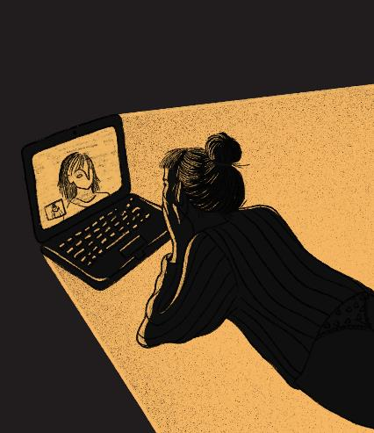
Format
Online, in person, or hybrid presentations have different facilitation requirements
Online: no travel needed and can be recorded and shared
In person: for networking or engaging in a shared experience
Hybrid: offers choice but requires careful planning
Image: Together, apart by Beatriz Leonardo is licensed CC BY-NC-SA 4.0. Cropped from original.
Notes:
Image prompt: Maybe this image is you right now! In it, we see a person lying comfortably at home, engaged in an online presentation on their laptop. The warm glow around them contrasts with the dark surroundings, symbolising the accessibility and intimacy that online presentations can offer.
Different presentation formats come with unique facilitation needs that can significantly impact engagement and effectiveness.
Online presentations eliminate the need for travel, making them convenient and easily recorded. Regardless of location, mobility, or circumstance, online presentations allow everyone to participate and feel included.
Right now, you are probably watching a recording of this live presentation that was made much easier by the event being online!
In-person presentations foster networking and create a shared experience, which can enhance connection and collaboration, but can be inaccessible for some
Hybrid formats can offer flexibility, but they require meticulous planning to ensure that both in-person and remote participants feel included and engaged.

Slide 8

Logistics & technology
Plan ahead to ensure access and reduce surprises
Ask attendees if they have any access requirements
Choose an accessible location
Check that audio and visuals are clear
Use live captioning and transcription and record the presentation
Test and practice tech
Recruit a co-facilitator
Image: Support your fellow human by Dumitru Ochievschi is licensed CC BY-NC-SA 4.0
Notes:
Image prompt: This image shows two pairs of silhouette figures with their arms on each other’s shoulders, forming a shared shape in the middle. It visually captures what it means to call on others for support. One of these figures is me in this presentation. All along the way I have been fortunate to have people supporting the logistics and resource creation, and assisting right now with technical support in this presentation.
It’s common to spend time planning presentation content, but thoughtfully organised logistics and technology are also crucial for a successful presentation. Planning ahead can significantly enhance accessibility, minimise unexpected issues and reduce your cognitive load.
invite attendees to share their access requirements to plan effectively.
You could add this to the event promotion or email.
I hope you noticed that in the information for today’s presentation.
Then, if the presentation is in person, select an accessible location.
could include flexible seating, adjustable lighting, mobility access, and support for people who are deaf / hard of hearing, or who have low / no vision
Whether in person or online, checking that your audio and visuals are clear is also essential.
Use a microphone, even online as I am now
check slides can be seen clearly by the audience, just as I did at the beginning of this presentation.
Incorporating live captioning and transcription not only aids those with hearing impairments but also benefits all attendees by providing a written record of the presentation.
Testing and practicing the technology beforehand can prevent technical glitches during the event.
key tip: recruit a co-facilitator to provide support or even act as an accessibility champion to manage the technical aspects of the presentation

Slide 9

Resources & materials
Provide equitable access to information
Share resources early
In presentation slides use:
preset layouts
meaningful alt text
high contrast colours
accessibility checker
Image: Speech Bubbles – Symbol – Generations Together by Wojtek Zatorski is licensed CC BY-NC-SA 4.0
Notes:
Image prompt:
This slide features a speech bubble icon. This image is half pixelated, highlighting the importance of blending supporting various types of communication to enhance engagement and communication during presentations.
You all already have access to this slide deck and notes that I’m using today so you could choose to engage with the content in advance, if you chose to. It is essential to share resources and materials to ensure all attendees have equitable access to information.
If you have a slide deck or other documents related to the presentation, share them early. gives time for attendees to access the materials via assistive technology like a screen reader.
I’ve used my slides today as a model of accessible presentation slides. Notice that I have
used the preset slide layouts instead of adding extra textboxes. The preset title and content boxes organise the information and preserve the reading order for people using screen readers
While you can’t read it right now, each image has meaningful alt text
In these slides, I’ve used high contrasty black text against a white background, and colour only for visual interest.
Additionally, employing an accessibility checker can help identify potential issues before sharing your content. I used Microsoft PowerPoint for this presentation, and its accessibility checker helps me review reading order, alt text, colour contrast, and other accessibility requirements.

Slide 10

Verbal & non-verbal delivery
Adjust and respond to participants
Describe or narrate visuals
Use orientating phrases
Keep a steady pace
Make your face visible
Seek feedback
Image: The Earth has music for those who listen by Preeti Singh for Creative Commons is licensed CC BY-NC-SA 4.0
Notes:
Image prompt: This image shows a person sitting on a record player shaped like the Earth, with plant life emerging from the speaker horn. It’s a metaphor for listening deeply—to context, to culture, to community. If we want our online delivery to be truly inclusive, it starts with listening to the people in the room, not just delivering content at them.
Effective presentation delivery relies on intentional verbal and non-verbal inclusive strategies
Adjust your approach based on participant reactions
Aim for an equitable experience for those watching or listening
It’s live — so practice these strategies in advance
Today, you've heard me explain the images on each slide and how they relate to the topic
Describing visuals or narrating actions helps people follow via audio
Keeps the audience connected to the content
I hope my explanations have helped you engage more with each slide
I’m not improvising these descriptions
As I said earlier, planning ahead reduces cognitive load — including planning image descriptions
Orientating phrases help guide people through the presentation
If slides are busy, let people know where to focus
Same goes for chat/comments — read them aloud or repeat the question
Keeping a steady pace helps people absorb information without feeling rushed
Making your face clearly visible supports connection and access
Helps with lip-reading and reading facial expressions
Remember, I checked at the start whether my face was clearly visible
Actively seeking feedback improves future presentations
Can be small check-ins during the session (like I’ve been doing today)
Or more formal follow-up afterwards
I’ll give you a way to get in touch at the end of this presentation

Slide 11
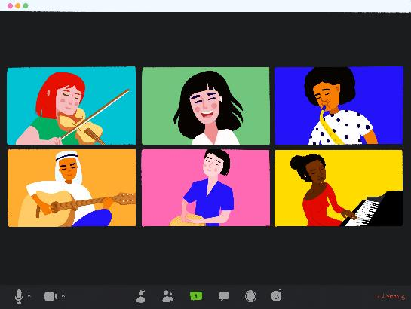
Interaction
Establish clear expectations for audience interaction
Provide guidelines
Enable a choice of verbal or text interaction
Encourage accessible online chat interaction
Image: Celebrate Togetherness by Lera Lytvyn is licensed CC BY-NC-SA 4.0
Notes:
Image prompt: This illustration shows six diverse individuals interacting over a video call, each playing a different instrument. It captures inclusive and accessible interaction, where people connect creatively regardless of location or background.
In a presentation like this, we don’t get heaps of direct interaction between participants
But there is interaction:
Between me and all of you
From you in the chat or verbally, if you choose to ask questions or comment
To support comfortable interaction, I shared some guidelines at the start
These included accessibility aids
And the option to interact verbally or via text
You can also interact in the chat during this session
To support chat accessibility, I shared some advice and examples
Keep in mind: in this kind of presentation, people might not expect much chat
Too much can get overwhelming
The key is setting expectations up front
And having a co-facilitator to help manage the chat if it gets a bit chaotic

Slide 12
Thank you!
Key recommendations:
Format
Logistics & technology
Resources & materials
Verbal & non-verbal delivery
Interaction
For more information or support after this event:
you have the slide file and we will email recording access details
contact Ed.Connect@uts.edu.au if you have any questions or feedback
Notes:
Thank you for your attention in this presentation.
I hope this demonstration of inclusive and accessible synchronous presentation practices has been engaging and useful.
To recap the key recommendations:
We discussed choosing the right format – online, in person or hybrid, based on audience needs
We talked about planning logistics and technology to ensure accessibility and smooth execution
Additionally, we emphasised the importance of providing accessible resources ahead of time,
engaging your audience with clear narration and visible expressions,
And setting clear guidelines for inclusive audience participation
For any further information or support, you already have the slide file with the links included.
We will email you with details of how you can access the recording when we have it ready.
Please feel free to reach out to Ed.Connect@uts.edu.au with any questions or feedback you may have.
Thanks again! I’ll now pause for some questions.

Slide 13
CC Licensing and Attribution
Except where otherwise noted, this slide file Inclusive and Accessible Practices for Synchronous Presentations is © University of Technology Sydney and made available under a CC BY 4.0 International License.
This slide file is a collection that incorporates other Creative Commons licensed material (attribution and licenses below). The license for this collection does not change the license applicable to original material included in this collection. If you use this collection, you must still adhere to the license conditions governing the incorporated materials. For example, material with Creative Commons NonCommercial licenses cannot be used commercially, and material with Creative Commons ShareAlike licenses must be licensed under identical terms if you modify the material.
Acknowledgement of Country: Gum tree by Jenny Wallace is licensed under CC BY-NC 2.0.
Title slide: Dialogue by Sebastian Aravena is licensed CC BY-NC-SA 4.0.
Format: Together, apart by Beatriz Leonardo is licensed CC BY-NC-SA 4.0.
Logistics & technology: Support your fellow human by Dumitru Ochievschi is licensed CC BY-NC-SA 4.0.
Resources & materials: Speech Bubbles – Symbol – Generations Together by Wojtek Zatorski is licensed CC BY-NC-SA 4.0.
Verbal & non-verbal delivery: The Earth has music for those who listen by Preeti Singh for Creative Commons is licensed CC BY-NC-SA 4.0.
Interaction: Celebrate Togetherness by Lera Lytvyn is licensed CC BY-NC-SA 4.0.

